Slide 1
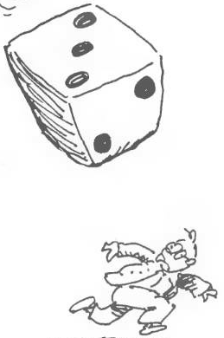
Sample Space & Probability
Chapter 3 Part 3
Dr. Abolfazl Saghafi
Assistant Professor of Statistics & Data Science
Data Science Program Director

Slide 2
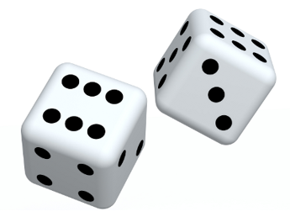
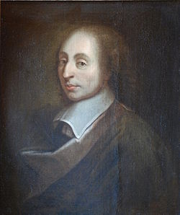

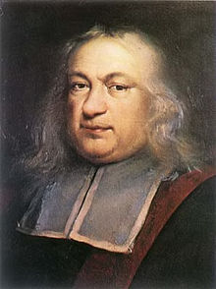
History
A 17th century, gambler Chevalier de Méré, made it to history by turning to Pascal for an explanation of his unexpected losses.
De Mere bet on getting at least one six on four rolls of a fair die (0.5177), he made considerable money over the years by making this bet and winning.
With the success of the first game, he modified the game by betting on getting at least a double six on 24 rolls of a pair of dice (0.4914). But he started losing money.
So he challenged his renowned friend Pascal to help him find an explanation. Pascal combined his efforts with his friend Fermat and the two of them laid out mathematical foundations for the theory of probability.
Notes:
And it all began …

Slide 3
Deterministic Vs Stochastic
For example, messing with genes
Experiment
There are more than one possible results or outcomes
Unknown possible Outcomes
Stochastic
The result of these experiments is predictable with certainty and is known prior to its conduct.
Known possible Outcomes
For example, rolling a die, picking a card
Deterministic
Repeats possible?
For example, the experiments that we conduct to verify the laws of science or established laws of other areas
No
Yes
These are called Random Experiments and from now on we deal with these experiments.
Notes:
Based on the possible results of an experiment, we classify the experiments into two groups: Stochastic where there are more than one possible outcome and you cannot tell which one shows up, or Deterministic where the result of these experiments is predictable with certainty and is known prior to its conduct.
In the stochastic branch, either we know the set of all the possible outcomes or we don’t. Random Experiments or Experiments for short are the ones with known set of possible outcomes and can be repeated multiple times. These are the type of experiments we will deal with in this course.

Slide 4

Sample Space
The sample space is our Universal set in set theory notations.
In a Random Experiment, Sample Space is the set of all possible outcomes. We show this set by capital letter S.
Example 1. In the experiment of throwing a die once
S={1, 2, 3, 4, 5, 6}
n(S)= 6
Example 2. Experiment of throwing a coin until a head appears
S={H, TH, TTH, …}
n(S)=
Aleph-naught
Example 3. Experiment of the measuring the lifetime of a car
S=[ 0, ∞ )
n(S)= 2

Slide 5
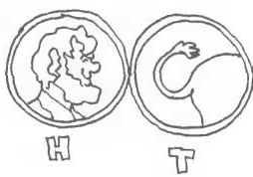

Event
In a Random Experiment, any subset of a Sample Space is called an event. We show events by capital letters A, B, …
Example 1. Experiment of throwing a fair die once
Example 2. Experiment of throwing a coin until a head appears
S={1, 2, 3, 4, 5, 6}
S={H, TH, TTH, …}
{1, 3, 5} ⊆ S
Event of having an
odd number
{H, TH, TTH} ⊆ S
{6} ⊆ S
Event of throwing the die at most three times
Event of having a 6
{ } ⊆ S
Impossible Event
{TH, TTH} ⊆ S
Event of throwing the die between 2 and 3 times

Slide 6
Different Event types
What is the type of the following events?
Example 1:
{1, 3, 5}
{6}
{ }
Example 2:
{H, TH, TTH}
{TH, TTH, TTTH, …}
Example 3:
(1, 10)
{0}
There are four different types of events.
1. Sure Event: S and any event that is certain to occur.
2. Impossible Event: φ and any event that is impossible to occur.
3. Simple Event: Any event that has only one element is called a simple event.
4. Compound Event: Any other event is called compound, these are a union of simple events.

Slide 7


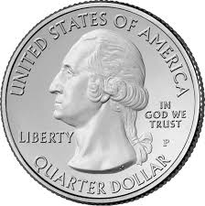
Example
There are 7 coins in a bag, 4 -1cents, 2 -5cents, and 1- 25cents.
You randomly pick two coins from the bag.
What is the sample space? Suppose order is important.
Determine the event of having the same valued coins.
1-cent
(1, 1)
5-cent
(1, 5)
1-cent
25-cent
(1, 25)
1-cent
(5, 1)
5-cent
5-cent
(5, 5)
25-cent
(5, 25)
25-cent
1-cent
(25, 1)
5-cent
(25, 5)
Notes:
S={(1, 1), (1, 5), (1, 25), (5, 1), (5, 5), (5, 25), (25, 1), (25, 5)}
E={(1, 1), (5, 5)}

Slide 8

Question
Suppose we are flipping three fair coins together, once.
Graph a tree diagram showing the results of this experiment.
What is the sample space of this experiment?
Determine the event of having the same face for the three coins.
Notes:
S = { HHH, HHT, HTH, THH, HTT, THT, TTH, TTT }
F = { HHH, TTT }

Slide 9
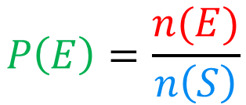
Probability
S
E
Suppose the sample space of an experiment is composed of n(S) disjoint simple events of equal chance, and suppose an arbitrary event E is composed of n(E) disjoint simple events.
Then the probability of event E which is denoted by Pr(E) or P(E) is computed as
• Likely: Probabilities closer to 1 indicates that the event is likely to occur.
• Unlikely: Probabilities closer to 0 indicate that the event is unlikely to occur.
$$P\left(E\right)=\frac{n(E)}{n\left(S\right)}$$
Probability of an event is a measure between 0 and 1 that describes the chance or likelihood of happening the event.
Notes:
So, the probability of E happening is the quotient of number of elements in E over number of elements in the sample space. This number shows how probable event E is before performing the corresponding experiment.
A probability of 1 indicates the event is certain (sure) to occur and a probability of 0 indicates the event is certain not to occur (impossible).

Slide 10


Examples
In the experiment of throwing a fair die once, determine
a) The sample space
b) Probability of the following events
A={1, 3, 5} B= {6} C={ }
Consider the situation of tossing a fair coin twice. Determine
a) The sample space
b) Probability of having a different face on each toss
c) Probability of at least 1 head
Notes:
S={1, 2, 3, 4, 5, 6}, n(S)=6
P(A)=n(A)/n(S)=3/6 P(B)=n(B)/n(S)=1/6 P(C)=0
S={HH, HT, TH, TT}, n(S)=4
A={HT, TH}, P(A)=2/4 B={TH, HT, HH}, P(B)=3/4

Slide 11
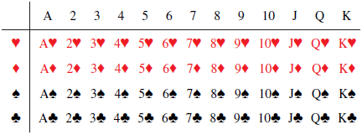
Example
Consider the situation of drawing ONE card from an ordinary deck of 52 cards. We draw ONE card at random, what is the probability that
a) the card is a heart card
b) the card is a picture card
c) the card is an ace
Notes:
a) Consider the event A as drawing a heart, then n(A)=13, and P(A)=13/52=1/4
b) Consider the event B as drawing a picture card, then n(B)=12, and P(B)=12/52=3/13
c) Consider the event C as drawing an ace card, then n(C)=4, and P(C)=4/52=1/13

Slide 12
Question
Two fair dice are tossed once. Construct the sample space of this experiment and compute the following probabilities.
b) Observing a 6 for the first die
c) The sum of the values of the two dice be greater than or equal to 10
d) The absolute value of the difference of the two dice be less than or equal 1
Notes:
Try writing down the sample space, then for each event, mark the corresponding members of the sample space, the probability is then the number of marked elements over the number of elements in the sample space.

Slide 13
Answer
S
With any probability question, it’s best to determine and write down the elements of the sample space. Computing probabilities then simplifies to just counting corresponding elements.
b)
c)
d)
Notes:
b) Consider the event B as having a 6 for the first tossing, then n(C)=6, and P(B)=6/36=1/6
c) Consider the event C as having a sum of 10 or more for the two dice, then n(C)=6, and P(C)=6/36=1/6
d) Define event D as having a absolute difference of at most 1 for the two dice, then n(D)=16, and P(D)=16/36=4/9

Slide 14
Axioms of Probability
Rule #1. The probability of the sample space is one
Rule #2. The probability of any given event is greater than or equal to zero
S
E’
E
Rule #3. The probability of any complement event can be computed using
S
A
B
Rule #4. If the events A and B are mutually exclusive then
If they are NOT mutually exclusive we have:
S
A
B
Notes:
We defined a probability function, here we discuss its properties. Here is where we learn to use set theory operations in computing probability.
Mixing #1 and #3, we cam conclude that P(φ)=1-P(S)=0

Slide 15
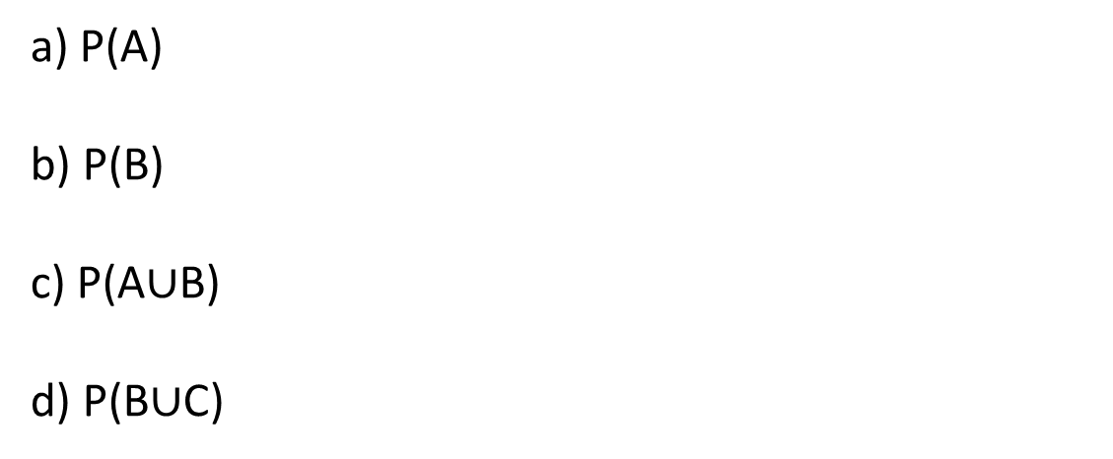
Example
S
A
1
B
The results of a certain experiment are shown in the following diagram. Calculate the probability of the following events.
7
2
8
5
4
a) P(A)
b) P(B)
c) P(A$∪$B)
d) P(B$∪$C)
3
C
9
6
Note: all sample points are equally likely to occur
Notes:
n(S)=9
n(A)=3, P(A)=3/9
n(B)=4, P(B)=4/9
n(AUB)= 6, P(AUB)=6/9 Or P(AUB)= P(A)+P(B)-P(A∩B)=3/9+ 4/9- 1/9= 6/9

Slide 16
Example
In translating probability statements, ∩ means “and”
U means “or”
Suppose
P(A)= 2/9 P(B)= 7/9 P(AUB)= 8/9
Compute the following probabilities.
a) P(B’)
b) P(A∩B)
c) P(A∆B)
d) P(A-B)
Notes:
a) P(B’)= 1-P(B)= 1-7/9= 2/9
b) P(A∩B)= P(A)+P(B)-P(AUB) = 2/9+ 7/9- 8/9= 1/9
c) P(A∆B)=P(AUB)-P(A∩B)= 8/9- 1/9= 7/9
d) P(A-B)=P(A)-P(A∩B)= 2/9- 1/9= 1/9
PAY ATTENTION (≠ 2/9- 7/9= -5/9)

Slide 17

Probability is between 0 and 1
Notes:
Be smart, don’t kill puppies!

Slide 18
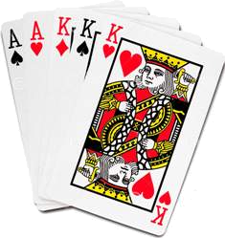
Question
Consider drawing a single card from an ordinary deck of 52 cards. What is the probability that
a) the card is not a king
b) the card is a king or diamond
c) the card is red or picture face
Define event A: the card is king
∩ means “and”
U means “or”
Define event B: the card is diamond
Notes:
a) P(A’)= 1-P(A)= 1-(4/52)= 48/52
b) P(B)= 13/52 P(AUB)= P(A)+ P(B)- P(A∩B)= (4/52)+ (13/52)- (1/52)=16/52
c) Try to find the answer, be confident

Slide 19
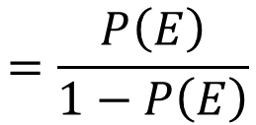
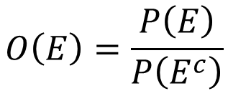

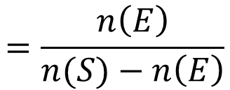
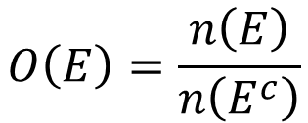
Odds
Suppose the probability of having twins, triplets, or more is 0.1, what are the odds of
For the event E, the odds denoted Odds(E) or O(E), is the ratio of the probability that the event E will occur to the probability that the event E will not occur
a) Having Twins, Triplets, or more
$$O\left(E\right)=\frac{P\left(E\right)}{P\left(E^{c}\right)}$$
$$=\frac{P\left(E\right)}{1−P\left(E\right)}$$
Read as: 1:9 one-to-nine
Equivalent formula:
b) Not having twins, triplets, or more
$$O\left(E\right)=\frac{n\left(E\right)}{n\left(E^{c}\right)}$$
$$=\frac{n\left(E\right)}{n(S)−n\left(E\right)}$$
Assumption:
9:1 nine-to-one
$$0<P\left(E\right)<1$$

Slide 20
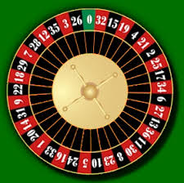
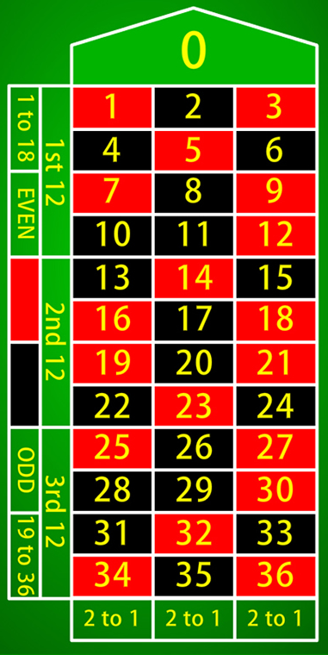
Question
In a game of roulette what are the odds of
a) winning when bet on a red square?
b) winning when bet on the first column?
Notes:
Something more practical and fun! Roulette!
a) I am excluding 0 for simplicity, if we include 0, then your chance of winning is less than 0.5, so you tell me what it means.
P(winning) = n(winning) / n(S) = 18 / 36 = 0.5
O(winning) = P(winning) / P(losing) = 0.5 / 0.5 = 1/1 1:1

Slide 21
Example
Determine the odds of the event A if there are seven ways the event may occur, out of twelve possible outcomes.
If the odds of the event A is 1-to-5, what is the probability of occurring A? What is the probability of A not occurring?
Notes:
n(A)= 7 n(S)= 12
O(A)= n(A)/(n(S)-n(A))= 7/(12-7)= 7/5 7-to-5
P(A)= 1/(1+5)= 1/6 P(A’)= 5/6

Slide 22
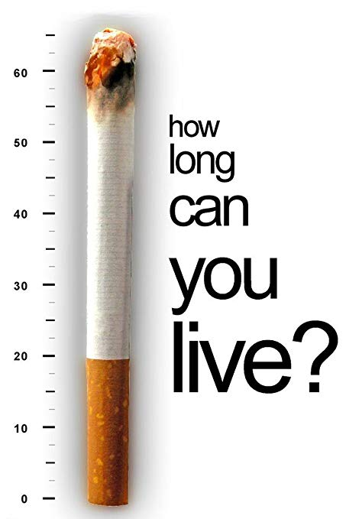
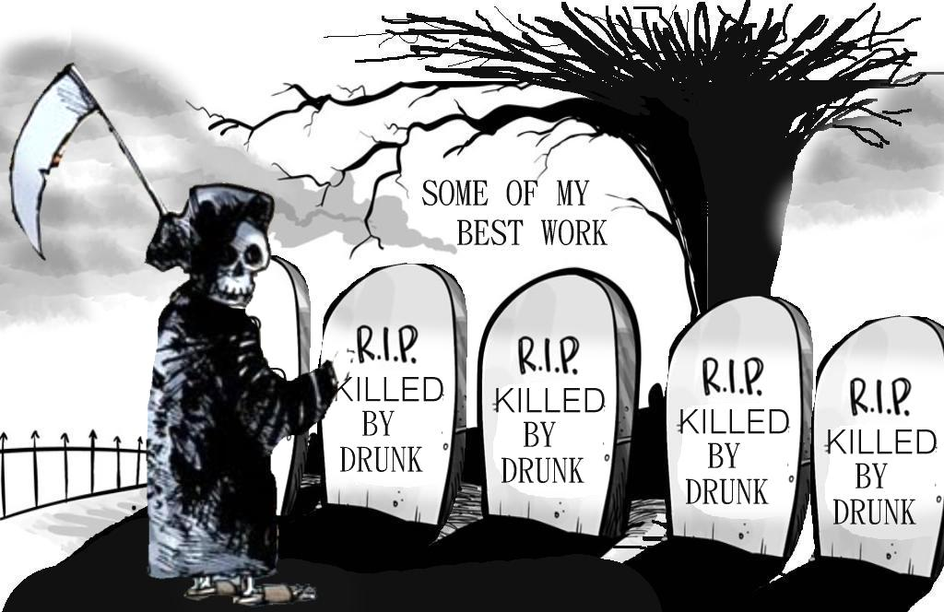
Practice Problems Part 3
1. Consider teens between 13 and 18 years old. Suppose the probability that a teen is obese is 0.11, the probability that a teen smokes is 0.35, and the probability that a teen is obese and smokes is 0.03. What is the probability that a teen
a) is obese and does not smoke?
b) smokes or is obese? c) does not smoke and is not obese?
2. On New Year's Eve, the probability of a driver being intoxicated is 0.32, the probability of a driver having a car accident is 0.09, and the probability of a driver having a car accident and being intoxicated is 0.06. On New Year's Eve, what is the probability of a driver
a) being intoxicated or having a car accident?
b) not having a car accident and not being intoxicated?
Notes:
Graphing a Venn Diagram usually helps with answering probability questions.
Answers are provided in Ch3 Practice Problem Solutions

Slide 23

Practice Problems Part 3
3. Suppose that 5% of the people in a population of adults have attempted suicide. It is also known that 20% of this population is living below the poverty level. In addition, a study suggests that 1% of adults in this population is living below the poverty level and have attempted suicide. What is the probability that an adult from this population
a) are living below the poverty level and have not attempted suicide?
b) are either living below the poverty level or have attempted suicide and not both?
4. Suppose you bet on a race horse that approximately wins 25 times in 100 races. What are the odds of the horse winning?
Suppose the odds of winning for a horse you bet on is three-to-four. What is the chance of winning for this horse?
If the odds of winning are two-to-five, what is the chance of losing?
Notes:
Answers are provided in Ch3 Practice Problem Solutions. More examples can be found from the following websites.
Sample Space:
http://www.mathgoodies.com/lessons/vol6/sample_spaces.html
Probability
https://www.mathsisfun.com/data/probability.html
http://www.algebra-class.com/examples-of-probability.html
Axioms of Probability
https://www.shmoop.com/basic-statistics-probability/and-or-probability-examples.html

